Slide 1

MoodleMobile Apps
The Moodle mobile app lets you keep up to date with all that's happening in your courses and on the site

Slide 2
What is Moodel Mobile app
Moodle Mobile is the official mobile app for Moodle. Browse the content of your courses, even when offline. Receive instant notifications of messages and other events. Quickly find and contact other people in your courses. Upload images, audio, videos and other files from your mobile device.

Slide 3

Download MoodleMobile app
MoodleMobile app is Available for Google play and App Store

Slide 4
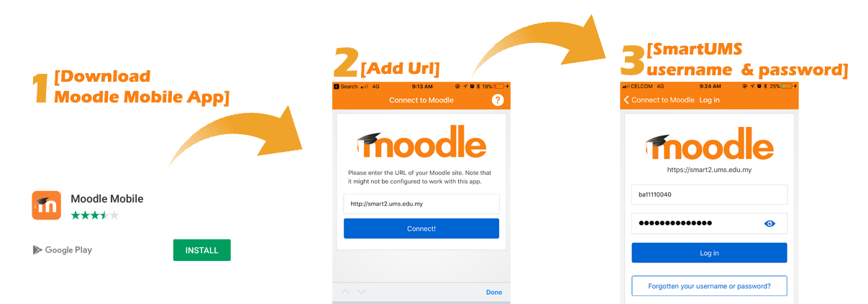
Download MoodleMobile app
Step 2(URL):
https://mdl.arabou.edu.kw/lebanon/

Slide 5
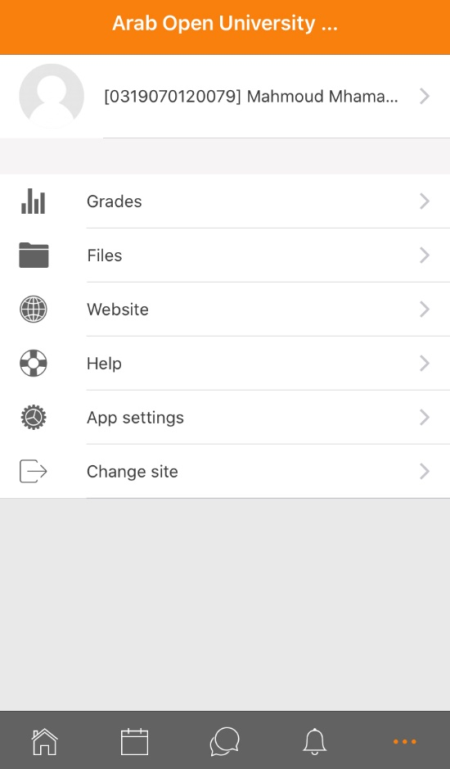
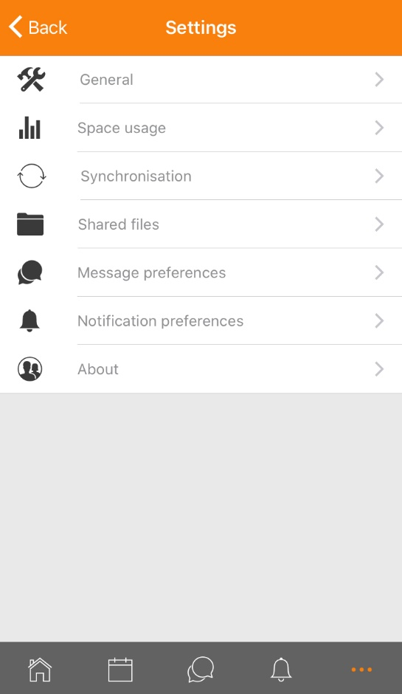
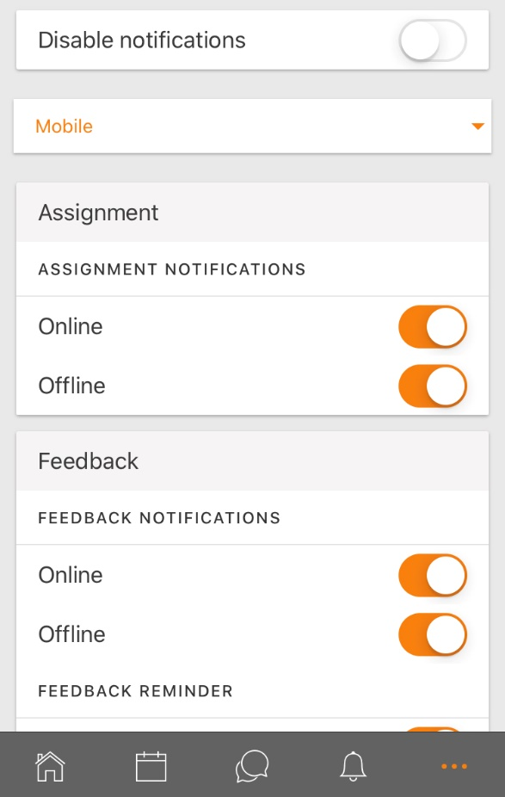
Enable Mobile Notifications
1. Go to the app settings then Notification preferences
2. Move the slider so that disable notifications is off
3. Move the slider to turn on notifications for assignment, feedback, forum etc. as required

Slide 6
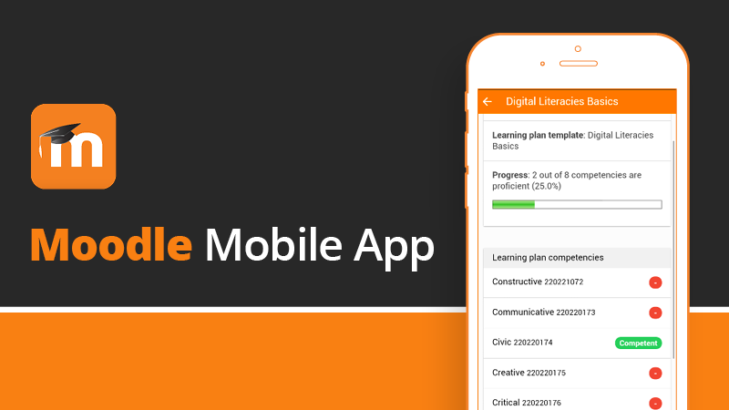
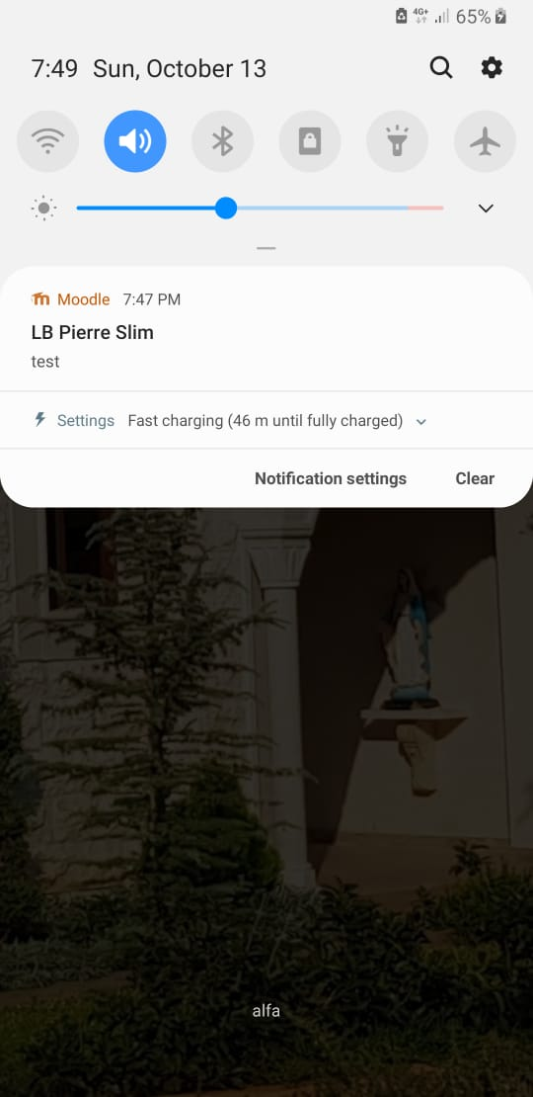
Now the Moodle mobile app is ready to make you up to date.

Slide 7
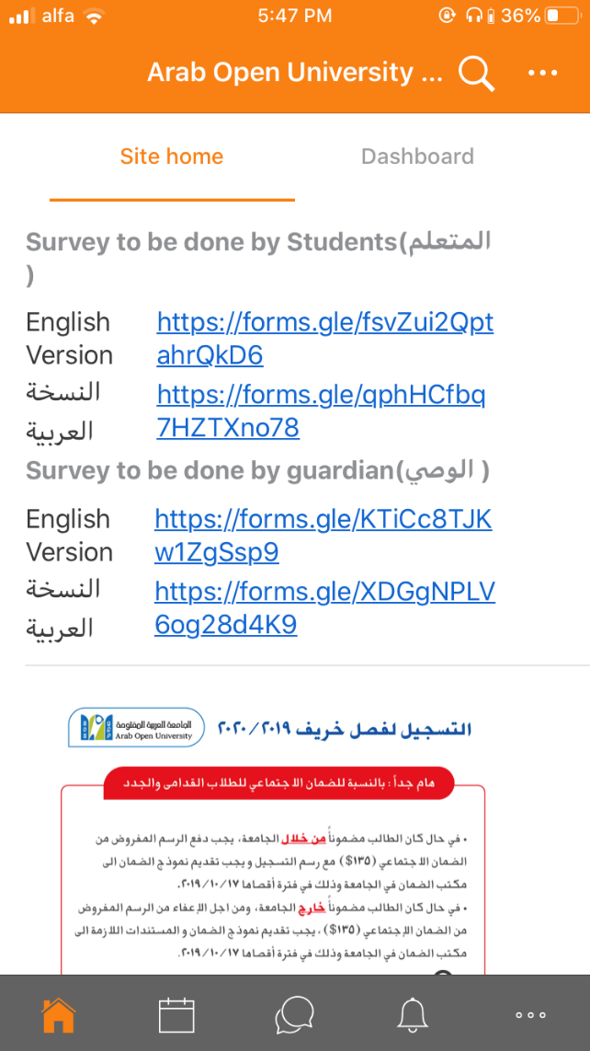
Features
When we open Mobile Moodle first page is about al the Academic News

Slide 8
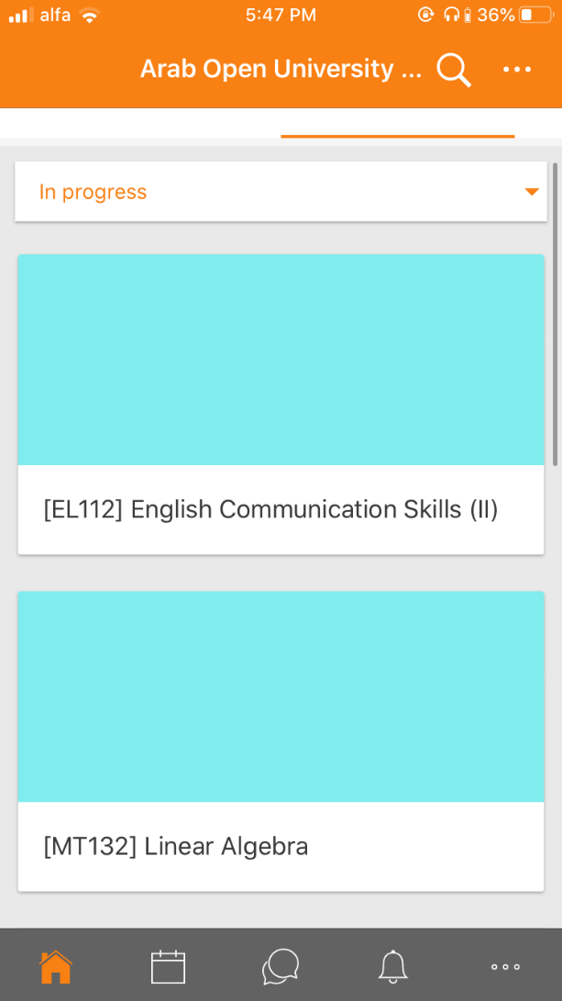
Features
When we click dashboard all courses which we are enrolled in it here.

Slide 9
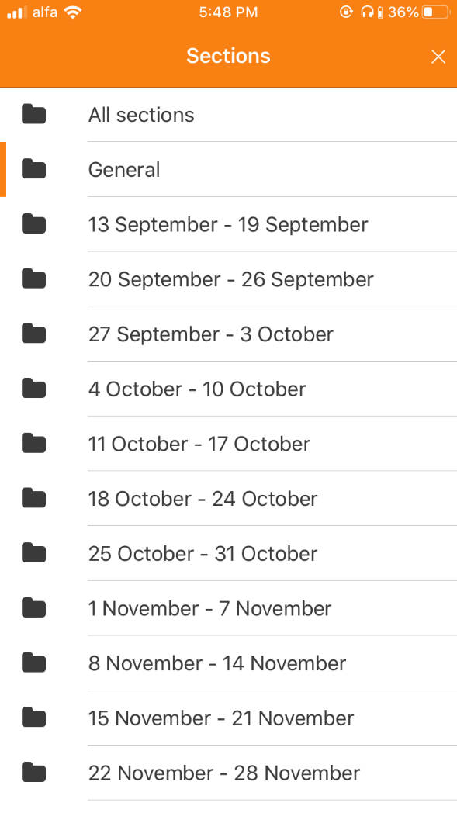
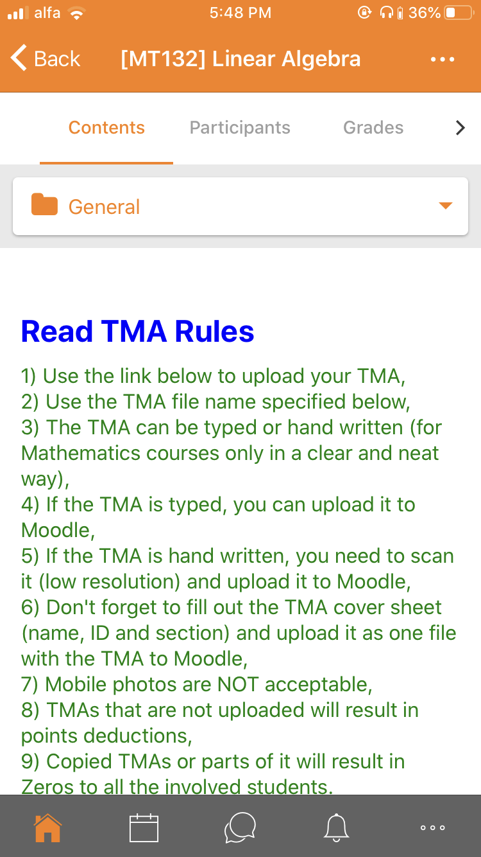
Features
When we click at any course we can choose any session we need or General for all courses an we can go to participants for connect doctor or our friends and of course the grades

Slide 10

Features
From the bottom you can go to calendar for know about al the up coming events and all the TMA upload time.
And you can go to notifications for any make up session or any update.

Slide 11
Thank you!!

